Slide 1
AdPiyasa -advertising platform app
Let’s Get Started…

Slide 2


from team D2Real
H W S Priyanga Fonseka 14208910
P A Dilshan Perera 14209006
H Thisaru Sanduranga 14209028
Chandrasiri H L K Kaushanga 14208883
De Silva,W G S Mayomi 14208894

Slide 3
Objectives ….
When world moving towards SMART, Systems also should be ..
Provides the best platform to publish Classifieds
Provides facilities for Businesses to
- host company profiles,
- publish Classifieds, attractive offers, new products
and promote their Businesses with many features

Slide 4
Target Audience
+ People who wants to publish Classifieds
+ People who wants to see Classifieds to find some stuff
+ Publish Classifieds for Business
+ Promote Business among clients
+ Businesses that needs to analyze their Customer behavior, Competitor behavior and the existing market

Slide 5
Features at a glance
Publish Free and Premium Classifieds
Publish Business Classifieds
Promote Businesses with Business Pages
Ranking Businesses in a field with Ratings
Analyze users behaviors and interaction with a Business
Analyze competitor behaviors and improve the Strategies

Slide 6

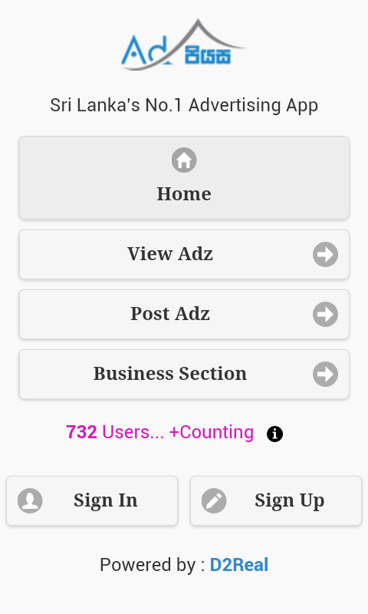

See AdPiyasa in Action!
~/. Main Screen
~/. Home Screen
~/. View Adz Screen
~/. Post Adz Screen
~/. Business Section
~/. Sign In Screen
~/. Sign Up Screen
~/. User Profile Panel
~/. + Help,
+ Contact Us,
+ About Us, etc…

Slide 7
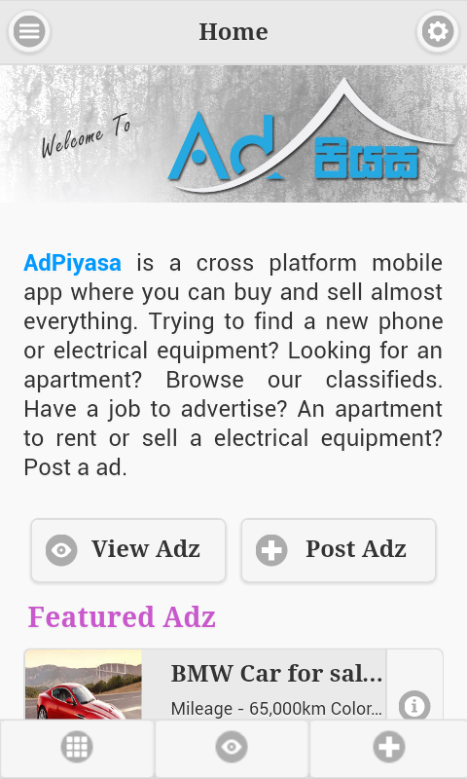
See AdPiyasa in Action!
~/. Main Screen
~/. Home Screen
~/. View Adz Screen
~/. Post Adz Screen
~/. Business Section
~/. Sign In Screen
~/. Sign Up Screen
~/. User Profile Panel
~/. + Help,
+ Contact Us,
+ About Us, etc…

Slide 8
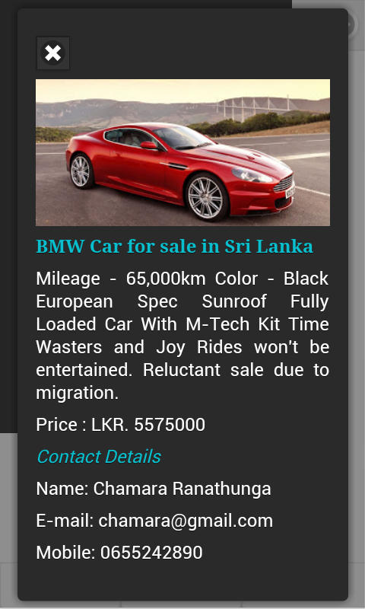
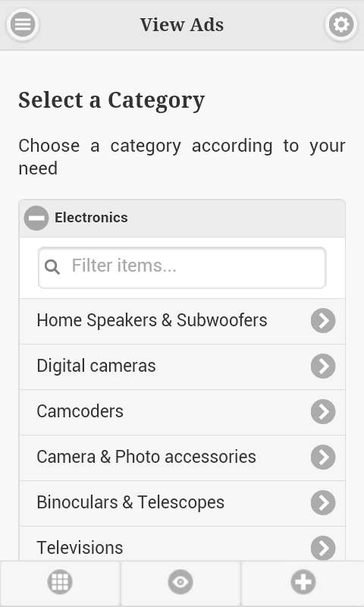
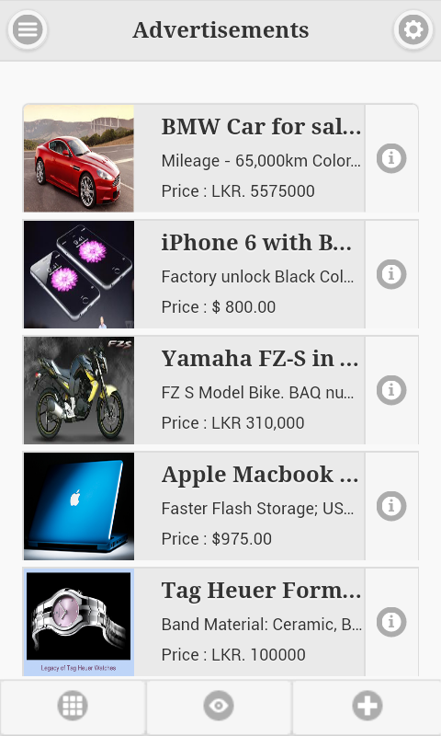
See AdPiyasa in Action!
~/. Main Screen
~/. Home Screen
~/. View Adz Screen
~/. Post Adz Screen
~/. Business Section
~/. Sign In Screen
~/. Sign Up Screen
~/. User Profile Panel
~/. + Help,
+ Contact Us,
+ About Us, etc…

Slide 9
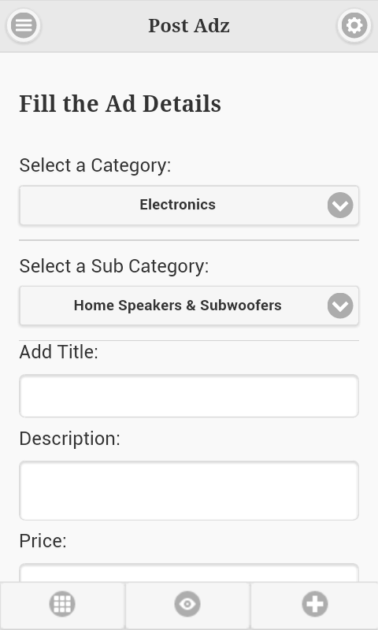
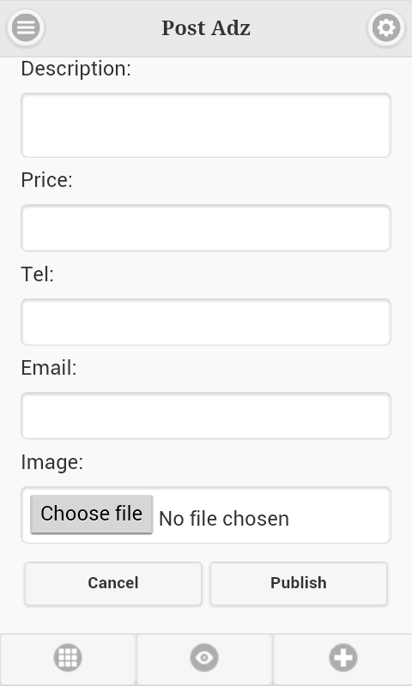
See AdPiyasa in Action!
~/. Main Screen
~/. Home Screen
~/. View Adz Screen
~/. Post Adz Screen
~/. Business Section
~/. Sign In Screen
~/. Sign Up Screen
~/. User Profile Panel
~/. + Help,
+ Contact Us,
+ About Us, etc…

Slide 10
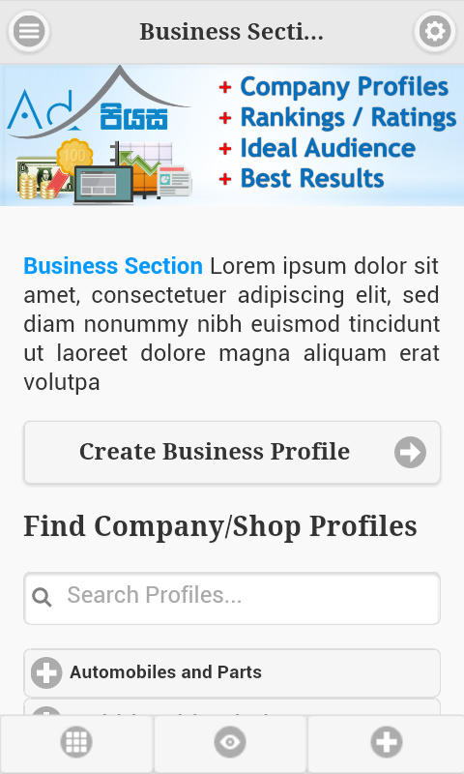

See AdPiyasa in Action!
~/. Main Screen
~/. Home Screen
~/. View Adz Screen
~/. Post Adz Screen
~/. Business Section
~/. Sign In Screen
~/. Sign Up Screen
~/. User Profile Panel
~/. + Help,
+ Contact Us,
+ About Us, etc…

Slide 11
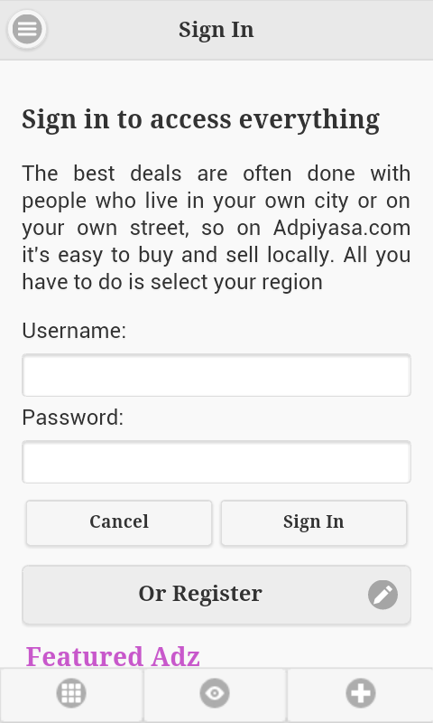
See AdPiyasa in Action!
~/. Main Screen
~/. Home Screen
~/. View Adz Screen
~/. Post Adz Screen
~/. Business Section
~/. Sign In Screen
~/. Sign Up Screen
~/. User Profile Panel
~/. + Help,
+ Contact Us,
+ About Us, etc…

Slide 12
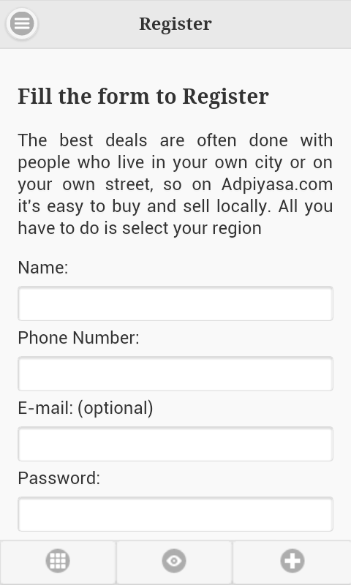
See AdPiyasa in Action!
~/. Main Screen
~/. Home Screen
~/. View Adz Screen
~/. Post Adz Screen
~/. Business Section
~/. Sign In Screen
~/. Sign Up Screen
~/. User Profile Panel
~/. + Help,
+ Contact Us,
+ About Us, etc…

Slide 13
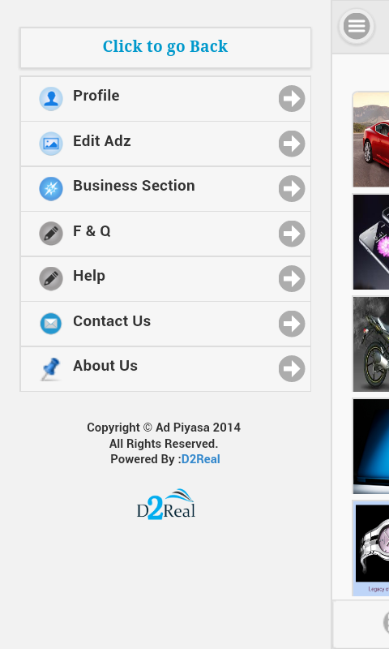
See AdPiyasa in Action!
~/. Main Screen
~/. Home Screen
~/. View Adz Screen
~/. Post Adz Screen
~/. Business Section
~/. Sign In Screen
~/. Sign Up Screen
~/. User Profile Panel
~/. + Help,
+ Contact Us,
+ About Us, etc…

Slide 14
Conclusions
The era of the digital advertising and marketing is fully dominated by the Desktops and Laptops in the past. But now it is changed and the Smart Devices plays a major role in digital world. So there is a need for a better solution which can modernize, revolutionize the Digital Advertising and Marketing. We have develop the best tool to do that in SMART way.

Slide 15

Get Started With
AdPiyasa
Thank you !
Present by Team D2Real

